Slide 1
Male Reproductive System

Slide 2
The organs of the reproductive system are
Internal reproductive organs
External genital organs

Slide 3
Primary Sex Organs (Gonads)
The primary reproductive organs or gonads consist of a pair of testes in the male and a pair of ovaries in the female.
In both sexes the mature gonads perform the dual function of
producing gametes (gametogenesis), that is, spermatozoa (sperm) in the male and ova (eggs) in the female
Secreting sex hormones testosterone in males and estrogen and progesterone in females.
In addition to the gonads the reproductive system in each sex includes a reproductive tract which is a system of ducts that are specialized to transport or house the gametes after they are produced plus accessory sex glands that empty their supportive secretions into these passageways

Slide 4
The major male accessory sex glands whose secretions provide the bulk of the semen are
Seminal vesicles
Prostate gland
Bulbourethral glands

Slide 5
Sperm exit each testis through the male reproductive tract consisting on each side of an epididymis, ductus (vas) deferens, and ejaculatory duct
These pairs of reproductive tubes empty into a single urethra, the canal that runs the length of the penis and empties to the exterior

Slide 6
The secondary sexual characteristics are the external characteristics not directly involved in reproduction that distinguish males and females such as body configuration and hair distribution

Slide 7
Physiologic Anatomy
Testis is composed of up to 900 coiled seminiferous tubules, each averaging more than one-half meter long, in which the sperm are formed
The sperm then empty into the epididymis, another coiled tube about 6 meters long
The epididymis leads into the vas deferens, which enlarges into the ampulla of the vas deferens immediately before the vas enters the body of the prostate gland

Slide 8
Two seminal vesicles one located on each side of the prostate empty into the prostatic end of the ampulla and the contents from both the ampulla and the seminal vesicles pass into an ejaculatory duct leading through the body of the prostate gland
Ejaculatory duct empty into the internal urethra.

Slide 9
The urethra is the last connecting link from the testis to the exterior
The urethra is supplied with mucus derived from a large number of minute urethral glands located along its entire extent and from bilateral bulbourethral glands (Cowper glands) located near the origin of the urethra

Slide 10
Sertoli Cells
Sertoli cells are large
They are present inside seminiferous tubule
The spermatogenic cells are attached to Sertoli cells by means of cytoplasmic connection
Sertoli cells support and nourish the spermatogenic cells
Secrete Mullerian regression factor
Secrete Inhibin and Activin
Secrete androgen binding protein and estrogen binding protein

Slide 11
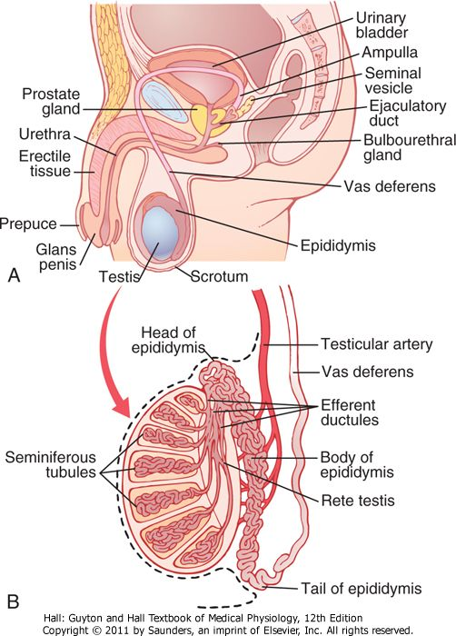

Slide 12
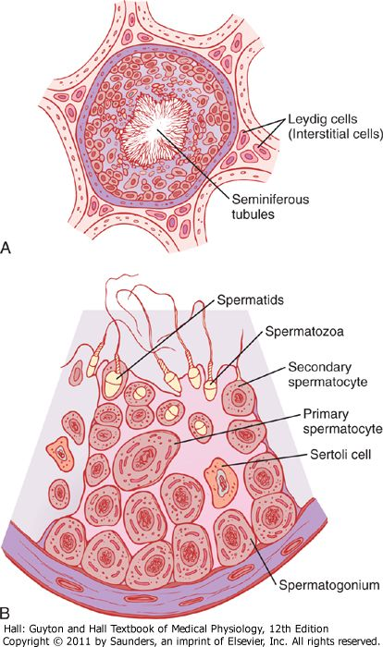

Slide 13
Blood-Testis Barrier
It is a mechanical barrier that separates blood from seminiferous tubules of the testes
It is formed by tight junctions between the adjacent Sertoli cells near the basal lamina of seminiferous tubule
It protects the seminiferous tubules and spermatogenic cells by preventing the entry of toxic substances from blood into testis
It permits the nutritive and other essential substances to pass through

Slide 14
Rete Testis
Each seminiferous tubule opens into a network of thin walled channels called Rete Testis

Slide 15
Interstitial Cells of Leydig
These are the hormone secreting cells of the testis situated between the seminiferous tubules

Slide 16
Spermatogenesis
Spermatogenesis occurs in the seminiferous tubules during active sexual life as the result of stimulation by anterior pituitary gonadotropic hormones, beginning at an average age of 13 years and continuing throughout most of the remainder of life but decreasing markedly in old age

Slide 17
Spermatogenesis
During formation of the embryo, the primordial germ cells migrate into the testes and become immature germ cells called spermatogonia
The spermatogonia begin to undergo mitotic division beginning at puberty and continually proliferate and differentiate through definite stages of development to form sperm

Slide 18
In the first stage of spermatogenesis the spermatogonia migrate among Sertoli cells toward the central lumen of the seminiferous tubule
Spermatogonia then become progressively modified and enlarged to form large primary spermatocytes
The primary spermatocytes undergo meiotic division to form two secondary spermatocytes. After few days, these too divide to form spermatids that are eventually modified to become spermatozoa (sperm)
The entire period of spermatogenesis, from spermatogonia to spermatozoa takes about 74 days

Slide 19
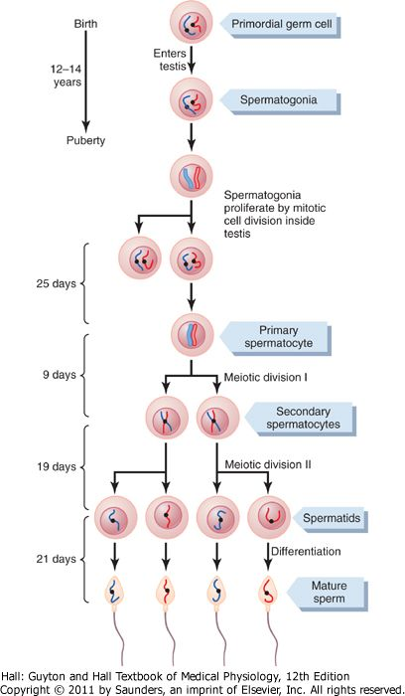

Slide 20
Formation of Sperm
When the spermatids are formed they still have the usual characteristics of epithelioid cells but soon they begin to differentiate and elongate into spermatozoa
Each spermatozoon is composed of a head and a tail
On the outside of the anterior two thirds of the head is a thick cap called the acrosome that is formed mainly from the Golgi apparatus. This contains a number of enzymes similar to those found in lysosomes of the typical cell
These enzymes play important role in allowing the sperm to enter the ovum and fertilize it

Slide 21
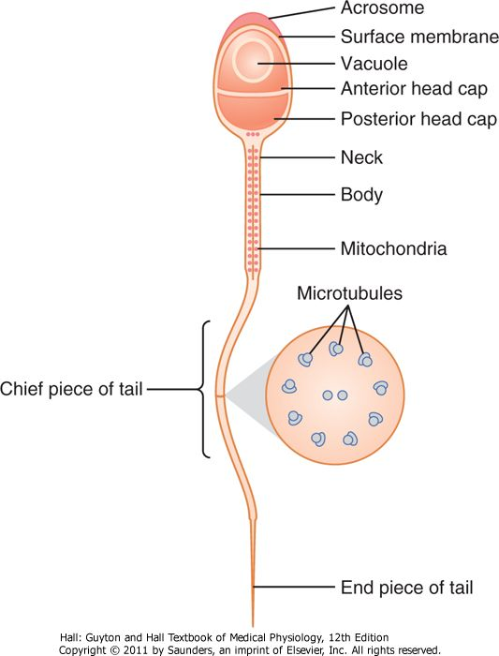

Slide 22
Hormonal Factors That Stimulate Spermatogenesis
Testosterone ( growth and division of the testicular germinal cells, which is the first stage in forming sperm)
Luteinizing hormone stimulates the Leydig cells to secrete testosterone
Follicle-stimulating hormone stimulates the Sertoli cells, without this stimulation the conversion of the spermatids to sperm (the process of spermiogenesis) will not occur

Slide 23
Estrogens formed from testosterone by the Sertoli cells when they are stimulated by follicle-stimulating hormone are also essential for spermiogenesis.
Growth hormone (as well as most of the other body hormones) is necessary for controlling background metabolic functions of the testes. Growth hormone specifically promotes early division of the spermatogonia

Slide 24
Other Factors Affecting Spermatogenesis
Increase in body temperature inhibits spermatogenesis ( internal temperature of scrotal sac is 2 degrees centigrade lower than body temperature)
(Regulation of temperature of scrotal testes is brought about by relaxation or contraction of scrotal musculature in summers and winters respectively)
Infections such as mumps cause degeneration of seminiferous tubules

Slide 25
The two testes of the human adult form up to 120 million sperms each day
A small quantity of these can be stored in the epididymis but most are stored in the vas deferens
The normal motile, fertile sperm are capable of flagellated movement through the fluid medium at velocity of 1 to 4 mm/min
Sperm can live for many weeks in the male genital ducts, once they are ejaculated in the semen, their maximal life span is only 24 to 48 hours at body temperature. At lowered temperatures semen can be stored for several weeks

Slide 26
Function of Seminal vesicles
Each seminal vesicle is a tortuous, loculated tube lined with a secretory epithelium that secretes a mucoid material containing an abundance of fructose, citric acid and other nutrient substances as well as large quantities of prostaglandins and fibrinogen (bulk 60% of the semen, nutrition)
During the process of emission and ejaculation each seminal vesicle empties its contents into the ejaculatory duct shortly after the vas deferens empties the sperm

Slide 27
Role of Prostaglandins
Prostaglandins help in fertilization in two ways
(1) by reacting with the female cervical mucus to make it more receptive to sperm movement
(2) by causing backward, reverse peristaltic contractions in the uterus and fallopian tubes to move the ejaculated sperm toward the ovaries

Slide 28
Function of the Prostate Gland
The prostate gland secretes a thin, milky fluid (30% of the semen) that contains calcium, citrate ion, phosphate ion, a clotting enzyme, and profibrinolysin
Prostatic fluid is alkaline in nature
Slightly alkaline prostatic fluid helps to neutralize the acidity of the other seminal fluids during ejaculation and thus enhances the motility and fertility of the sperm

Slide 29
Capacitation of spermatozoa is required for fertilization of the ovum
Spermatozoa when they leave the epididymis, their activity is held in check by multiple inhibitory factors secreted by the genital duct epithelia.
On coming in contact with the fluids of the female genital tract multiple changes occur that activate the sperm for the final processes of fertilization. These collective changes are called capacitation of the spermatozoa. This normally requires 1 to 10 hours

Slide 30
Capacitation
The uterine and fallopian tube fluids wash away the various inhibitory factors that suppress sperm activity in the male genital ducts
The spermatozoa in the fluid of the male genital ducts are continually exposed to many floating CHOLESTEROL vesicles from the seminiferous tubules
This cholesterol is continually added to the cellular membrane covering the sperm acrosome, toughening the membrane and preventing release of its enzymes.
The sperm deposited in the vagina swim away from the cholesterol vesicles upward into the uterine cavity, and they gradually lose much of their other excess cholesterol over the next few hours.
As a result the membrane at the head of the sperm (the acrosome) becomes weaker

Slide 31
The membrane of the sperm also becomes more permeable to calcium ions
The calcium ions also cause changes in the cellular membrane that cover the leading edge of the acrosome making it possible for the acrosome to release its enzymes rapidly and easily as the sperm penetrates the layers surrounding the ovum

Slide 32
Acrosome Reaction
When the sperm reaches the zona pellucida of the ovum, the anterior membrane of the sperm binds specifically with receptor proteins in the zona pellucida
The entire acrosome rapidly dissolves and all the acrosomal enzymes are released. Within minutes these enzymes open a pathway for passage of the sperm head through the zona pellucida to the inside of the ovum. Within another 30 minutes the cell membranes of the sperm head and of the oocyte fuse with each other to form a single cell

Slide 33
Why Does Only One Sperm Enter the Oocyte?
Within a few minutes after the first sperm penetrates the zona pellucida of the ovum, calcium ions diffuse inward through the oocyte membrane and cause multiple cortical granules to be released by exocytosis from the oocyte into the perivitelline space. These granules contain substances that permeate all portions of the zona pellucida and prevent binding of additional sperm and they even cause any sperm that have already begun to bind to fall off

Slide 34
Cryptoorchidism
Failure of a testis to descend from the abdomen into the scrotum at or near the time of birth of a fetus

Slide 35
Male sex hormones (androgens) secreted by the testes are
Testosterone(most abundant)
Dihydrotestosterone
Androstenedione

Slide 36
Testosterone that becomes fixed to the tissues is converted within the tissue cells to dihydrotestosterone especially in certain target organs such as the prostate gland in the adult and the external genitalia of the male fetus
Some actions of testosterone are dependent on this conversion whereas other actions are not

Slide 37
Chemistry of Androgens
All androgens are steroid compounds
Both in the testes and in the adrenals, the androgens can be synthesized either from cholesterol or directly from acetyl coenzymeA

Slide 38
Testosterone is sereted from the interstitial cells of Leydig which lie in the interstices between the seminiferous tubules and constitute about 20 percent of the mass of the adult testes
Leydig cells are almost nonexistent in the testes during childhood
These cells are numerous in the newborn male infant for the first few months of life and in the adult male after puberty
At both these times the testes secrete large quantities of testosterone

Slide 39
97% of the Testosterone is in the bound form
with albumin and sex hormone binding globulin
In certain target tissues much of the Testosterone is converted to Dihydrotestosterone such as in prostate gland in the adult and external genitalia of the male fetus

Slide 40
Degradation and Excretion of Testosterone
The testosterone that does not become fixed to the tissues is rapidly converted by the liver into androsterone and dehydroepiandrosterone and simultaneously conjugated as either glucuronides or sulfates. These are excreted either into the gut by way of the liver bile or into the urine through the kidneys.

Slide 41
Production of Estrogen in the Male
The concentration of estrogens in the fluid of the seminiferous tubules is quite high and plays an important role in spermiogenesis. This estrogen is believed to be formed by the Sertoli cells by converting testosterone to estradiol
Much larger amounts of estrogens are formed from testosterone and androstanediol in other tissues (such as skin and adipocytes) especially the liver accounting for as much as 80 percent of the total male estrogen production

Slide 42
Testosterone is responsible for the distinguishing characteristics of the masculine body
During fetal life the testes are stimulated by chorionic gonadotropin from the placenta to produce moderate quantities of testosterone throughout the entire period of fetal development and for 10 or more weeks after birth
No testosterone is produced during childhood until about the ages of 10 to 13 years.
Testosterone production increases rapidly under the stimulus of anterior pituitary gonadotropic hormones at the onset of puberty and lasts throughout most of the remainder of life

Slide 43
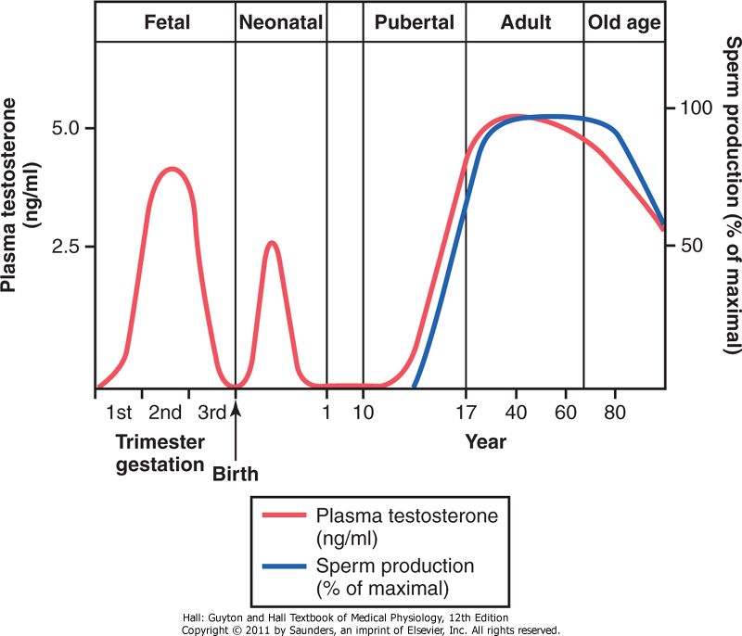

Slide 44
Testosterone During Fetal Life
Testosterone is secreted first by the genital ridges and later by the fetal testes and is responsible for the development of the male reproductive organs

Slide 45
Effect of Testosterone to Cause Descent of the Testes
The testes descend into the scrotum during the last 2 to 3 months of gestation when the testes begin secreting reasonable quantities of testosterone

Slide 46
Puberty
Puberty is usually referred to as maturation of reproductive system and the development of secondary sexual characteristics
The average age for onset of puberty is between 10-13 years
First change at puberty is enlargement of testes and scrotum and scrotum becomes pigmented and rugose
This is followed by increase in the size of penis, appearance of pubic hair (pubarche), enlargement of accessory sex glands, appearnce of secondary sexual characteristics
Early morning erections and discharge of seminal fluid start taking place
An acceleration of linear growth and increase in body weight

Slide 47
Puberty (cont)
The hormones responsible for the start of puberty changes are the androgens (especially Testosterone) secreted by the testes
The adrenal cortex also starts contributing androgens (adenarche-increase in androgen production at the onset of puberty)

Slide 48
Effect of Testosterone on Development of Adult Primary and Secondary Sexual Characteristics
After puberty increasing amounts of testosterone secretion causes the enlargement male genital organs
Testosterone causes the secondary sexual characteristics of the male to develop, beginning at puberty and ending at maturity

Slide 49
Effect on the Distribution of Body Hair
Testosterone causes growth of hair
over the pubis
(2) upward along the linea alba of the abdomen sometimes to the umbilicus and above
(3) on the face
(4)on the chest

Slide 50
Baldness
Testosterone decreases the growth of hair on the top of the head
Baldness is a result of two factors
a genetic background
superimposed on this genetic background large quantities of androgenic hormones

Slide 51
Effect on the Voice
Testosterone causes hypertrophy of the laryngeal mucosa and enlargement of the larynx.
This causes at first a relatively discordant, cracking voice but this gradually changes into the typical adult masculine voice

Slide 52
Testosterone Increases Thickness of the Skin and Can Contribute to Development of Acne Testosterone also increases the rate of secretion of the body's sebaceous glands

Slide 53
Testosterone Increases Protein Formation and Muscle Development
Protein anabolic effect
Testosterone Increases Bone Matrix and Causes Calcium Retention

Slide 54
Testosterone has a specific effect on the pelvis
narrow the pelvic outlet
(2) lengthen it
(3) cause a funnel-like shape instead of the broad ovoid shape of the female pelvis
(4) greatly increase the strength of the entire pelvis
In the absence of testosterone the male pelvis develops into a pelvis that is similar to that of the female

Slide 55
Testosterone Increases Basal Metabolic Rate
Testosterone Increases Red Blood Cells
Testosterone causes sodium and water retention

Slide 56
Testosterone increases rate of linear bone growth but also causes closure of epiphysis

Slide 57
Mechanism of Action
Testosterone stimulates production of proteins in target organs or tissues Testosterone binds to the cytoplasmic receptor This combination migrates to the cell nucleus where it binds with a nuclear protein and induces DNA-RNA transcription

Slide 58
Control of Male Sexual Functions by Hormones from the Hypothalamus and Anterior Pituitary Gland
Role of
GnRH (Hypothalamus)
LH (Ant Pituitary)
FSH (Ant Pituitary)

Slide 59
GnRH is secreted intermittently a few minutes at a time once every 1 to 3 hours.
The intensity of this hormone's stimulus is determined in two ways:
(1) by the frequency of these cycles of secretion
(2) by the quantity of GnRH released with each cycle.

Slide 60
The secretion of LH by the anterior pituitary gland is also cyclical with LH following fairly faithfully the pulsatile release of GnRH
FSH secretion increases and decreases only slightly with each fluctuation of GnRH secretion
It changes more slowly over a period of many hours in response to longer-term changes in GnRH

Slide 61
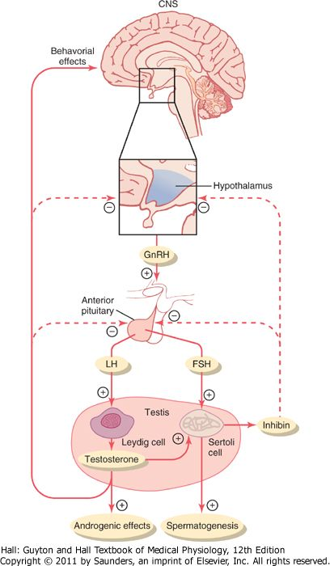

Slide 62
Human Chorionic Gonadotropin Secreted by the Placenta During Pregnancy Stimulates Testosterone Secretion by the Fetal Testes
It circulates both in the mother and in the fetus This hormone has almost the same effects on the sexual organs as LH.
During pregnancy if the fetus is a male hCG from the placenta causes the testes of the fetus to secrete testosterone. This testosterone is critical for promoting formation of the male sexual organs

Slide 63
Puberty and Regulation of Its Onset
During childhood the hypothalamus does not secrete significant amounts of GnRH
During childhood the slightest secretion of any sex steroid hormones exerts a strong inhibitory effect on hypothalamic secretion of GnRH
At the time of puberty the secretion of hypothalamic GnRH breaks through the childhood inhibition and adult sexual life begins

Slide 64
Male Adult Sexual Life and Male Climacteric
Most men begin to exhibit slowly decreasing sexual functions in their late 50s or 60s
The decrease in male sexual function is called the male climacteric.
Occasionally the male climacteric is associated with symptoms of hot flushes, suffocation, and psychic disorders similar to the menopausal symptoms of the female

Slide 65
Impotence
In the presence of sexual desire and favorable circumstances the person cannot attain or sustain erection of penis

Slide 66
Hypogonadism &Hypergonadism
Hypogonadism is a condition characterized by reduction in functional activity of the gonads
Hypergonadism is a condition characterized by hyper secretion of sex hormones

Slide 67
Causes of Hypogonadism
Congenital non-functional testes
Cryptorchidism
Pituitary disorder and hypothalamic disorder (hypogonadotropic hypogonadism)
Castration
Defect in androgen receptors
Hypogonadism caused by testicular disorders increases gonadotropin secretion (hypergonadotropic hypogonadism)

Slide 68
Causes of Hypergonadism
Tumor of the Leydig cells

Slide 69
Hypogonadism in fetus
When the testes of a male fetus are nonfunctional during fetal life none of the male sexual organs and characteristics develop in the fetus

Slide 70
Hyogonadism after Puberty
The sexual organs regress in size
Prostate and seminal vesicles undergo atrophy
Voice regresses from the bass quality only slightly
There is loss of masculine hair production
Loss of the thick masculine bones
Loss of the musculature
Sexual desires are decreased
Erection can occur but ejaculation is rare

Slide 71
Hypogonadism before Puberty
When a boy loses his testes before puberty a state of eunuchism begins in which he continues to have infantile sex organs and other infantile sexual characteristics throughout life
The height of an adult eunuch is slightly greater than that of a normal man because the bone epiphyses are slow to unite although the bones are quite thin and the muscles are considerably weaker than those of a normal man
The voice is childlike, there is no loss of hair on the head, and the normal adult masculine hair distribution on the face and elsewhere does not occur

Slide 72
Adiposogenital syndrome, Fröhlich syndrome, or hypothalamic eunuchism
It is caused by genetic inability of the hypothalamus to secrete normal amounts of GnRH. This is often associated with a simultaneous abnormality of the feeding center of the hypothalamus causing the person to overeat
Obesity occurs along with eunuchism.

Slide 73
Hypergonadism
Interstitial Leydig cell tumors are rare but when they do develop they sometimes produce as much as 100 times the normal quantities of testosterone
In young children such tumors cause rapid growth of the musculature and bones but also cause early uniting of the epiphyses
These tumors also cause excessive development of the male sexual organs, all skeletal muscles, and other male sexual characteristics (early puberty)

Slide 74
More common than the interstitial Leydig cell tumors are tumors of the germinal epithelium
Because germinal cells are capable of differentiating into almost any type of cell many of these tumors contain multiple tissues, such as placental tissue, hair, teeth, bone, skin, all found together in the same tumorous mass called teratoma.
These tumors often secrete few hormones but if a significant quantity of placental tissue develops in the tumor it may secrete large quantities of hCG with functions similar to those of LH
Estrogenic hormones are sometimes secreted by these tumors and cause the condition called gynecomastia (overgrowth of the breasts)

